Slide 1

Multimodel Emotion Recognition

Slide 2
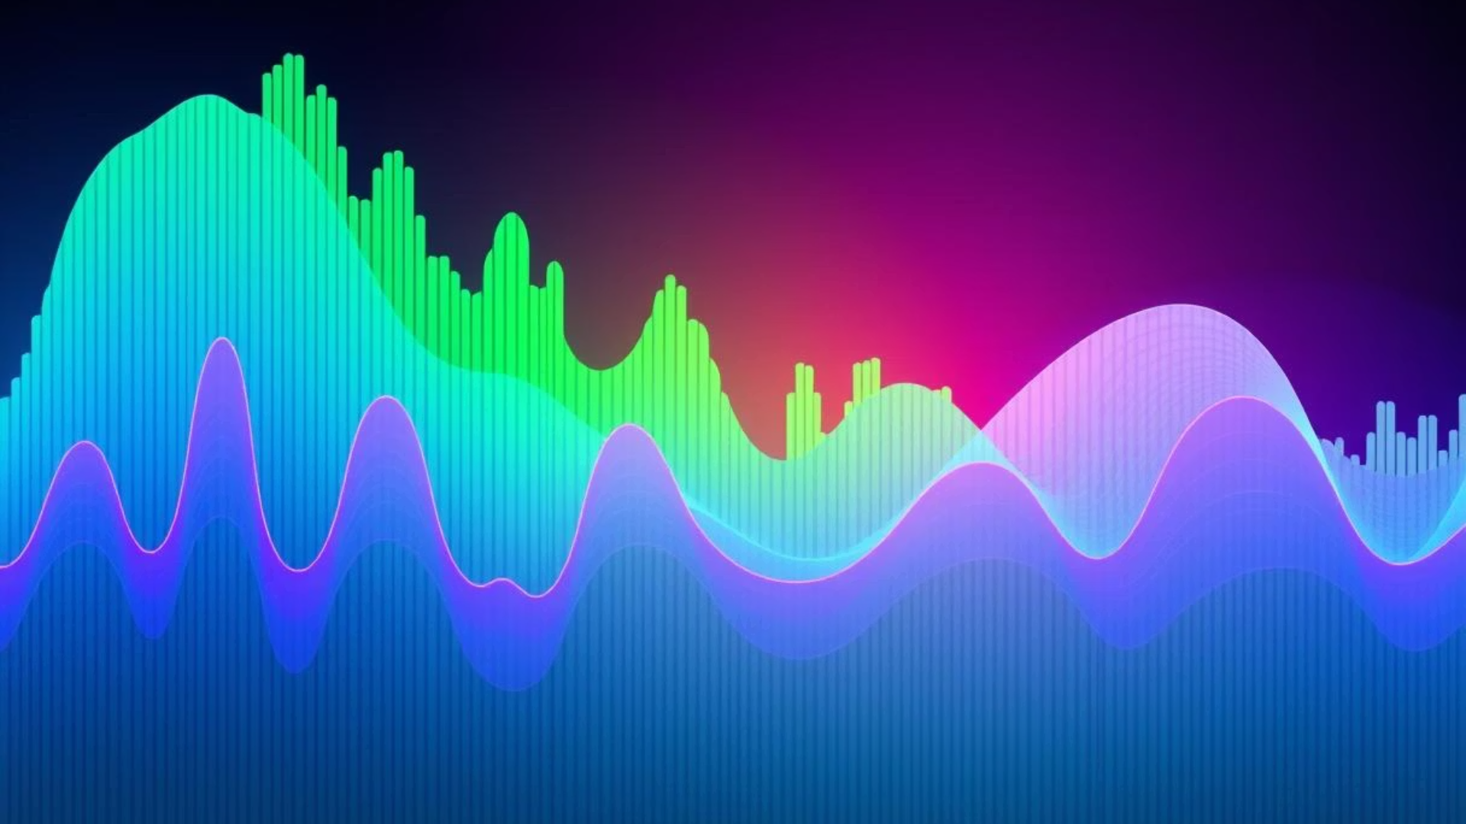
Speech Emotion Recognition
Speech Emotion Recognition (SER) refers to the process of automatically identifying human emotions from spoken audio using machine learning and deep learning techniques.
Although humans can easily identify emotions through voice, it's a challenging task for machines due to differences in accents, tones, speaking rates, background noise, and more. The goal is to build a robust model that can understand these subtle signals and classify emotions accurately.
We use CNNs to extract deep features from audio spectrograms (visual representations of audio). CNNs are effective in recognizing patterns in images, making them suitable for emotion detection from sound.
Why is SER Important?
Enhances human-computer interaction
Useful in call centers, healthcare, mental health detection, virtual assistants, etc.
Helps machines understand not just what is said, but how it is said.

Slide 3

Objective
To develop a dual-mode Emotion Recognition System that detects human emotions from both speech and textual inputs using advanced deep learning and NLP techniques.
To implement a CNN-based Speech Emotion Recognition (SER) model that extracts features like MFCCs, pitch, tone, and intensity from spectrograms for accurate voice emotion classification.
To perform sentiment and emotion analysis on translated text using Hugging Face's DistilBERT, VADER, and TextBlob for deeper emotional understanding.
To support multilingual input, where non-English audio/text is translated into English to ensure wider accessibility.
To evaluate and validate model performance on standard datasets, ensuring robustness, accuracy, and generalizability across diverse speech and text samples.
To explore real-world use cases of emotion-aware AI in:
Customer service automation
Mental health and healthcare monitoring
Education and virtual learning platforms
To provide a real-time, user-friendly web interface for emotion detection through live audio recording or file upload, delivering insights on both how and what was said.
Smart city surveillance

Slide 4

Significance
Bridging the Emotional Gap:Enables machines to interpret and respond to human emotions, fostering more empathetic and meaningful human-computer interactions.
Smart City Applications:Enhances surveillance systems by detecting emotional cues such as stress, panic, or aggression, aiding in crowd control and emergency response.
Enhanced User Experience:Elevates the quality of AI-driven services like virtual assistants, customer support, and IVR systems by making them emotionally responsive and user-centric.
Mental Health Monitoring:Assists in the early detection of emotional disturbances through vocal patterns, supporting mental health diagnostics and intervention planning.
Personalized Engagement:Boosts user involvement in e-learning, gaming, and entertainment by delivering emotion-aware content tailored to individual moods.
Towards Human-Centered AI:Represents a step forward in building socially aware and empathetic AI systems, making technology more natural, intuitive, and aligned with human needs.

Slide 5

Benefits
Intelligent Call Centers & Citizen Services
Emotion detection helps prioritize urgent or emotional calls in government helplines.
Leads to faster resolution and enhanced citizen satisfaction.
Mental Health Monitoring in Public Programs
SER-enabled kiosks or apps can detect signs of stress or depression during voice-based check-ins.
Supports early intervention in urban healthcare and welfare initiatives.
Corporate & Workplace Optimization
Emotion-aware virtual assistants track employee mood trends during meetings or feedback sessions.
Helps build responsive and mentally healthier workspaces.
Education & Smart Classrooms
Detects student confusion, boredom, or disengagement during online sessions.
Enables adaptive learning and improved teacher-student interaction.
Smart City Surveillance & Public Safety
Real-time SER in public surveillance can detect panic, fear, or aggression, enabling quick emergency response.
Enhances urban safety infrastructure using emotional signals.

Slide 6
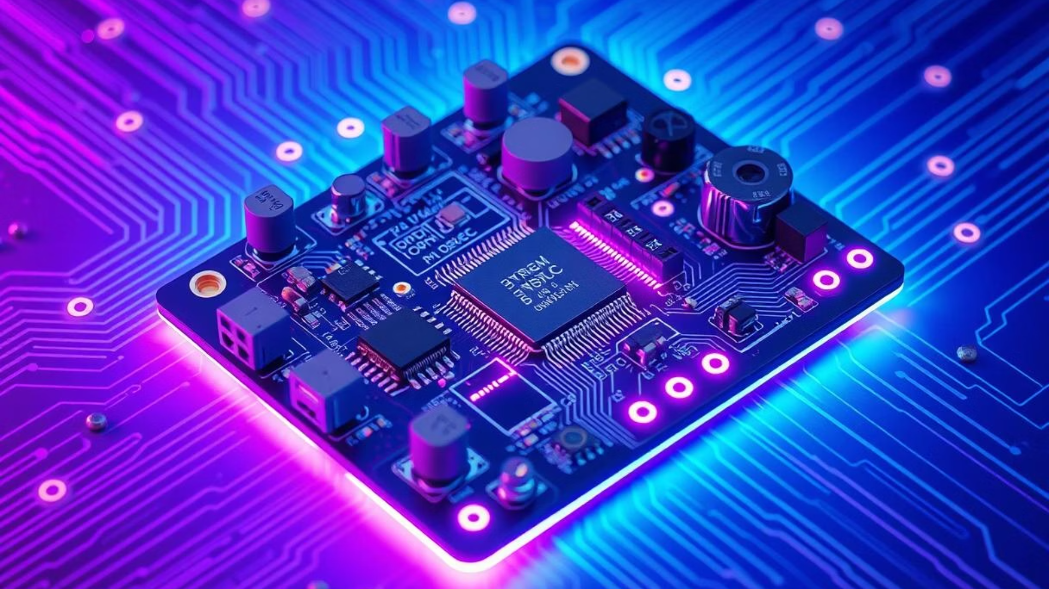
Technology Used
Component
Tools/Technologies
Purpose
Audio Processing
Librosa, SoundFile
Extract audio features like MFCCs and spectrograms for emotion analysis.
Speech Emotion AI
TensorFlow (CNN Model)
Employ deep learning to classify emotions from mel-spectrogram representations of speech.
Text Emotion AI
Hugging Face DistilBERT
Utilize transformer-based models to detect and classify a wide range of text-based emotions.
Sentiment Analysis
VADER, TextBlob
Provide sentiment polarity scores (positive, negative, neutral) and overall tone from textual data.
Translation
Googletrans API
Enable the processing of non-English text by translating it into English for emotion analysis.
Speech-to-Text
SpeechRecognition, PyDub
Transcribe spoken input into text, allowing for emotion processing using textual analysis techniques.
Web Interface
Streamlit
Create an interactive and user-friendly platform for real-time emotion recognition and visualization.

Slide 7
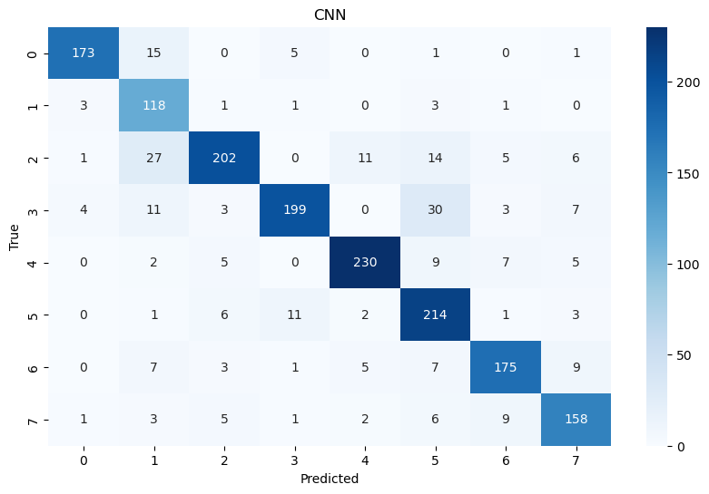
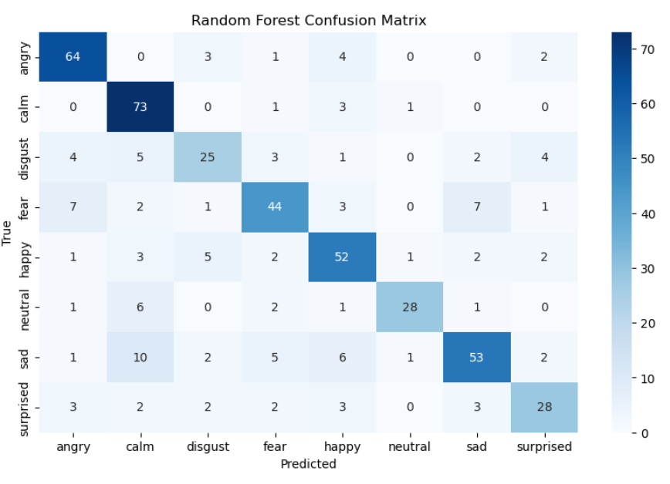
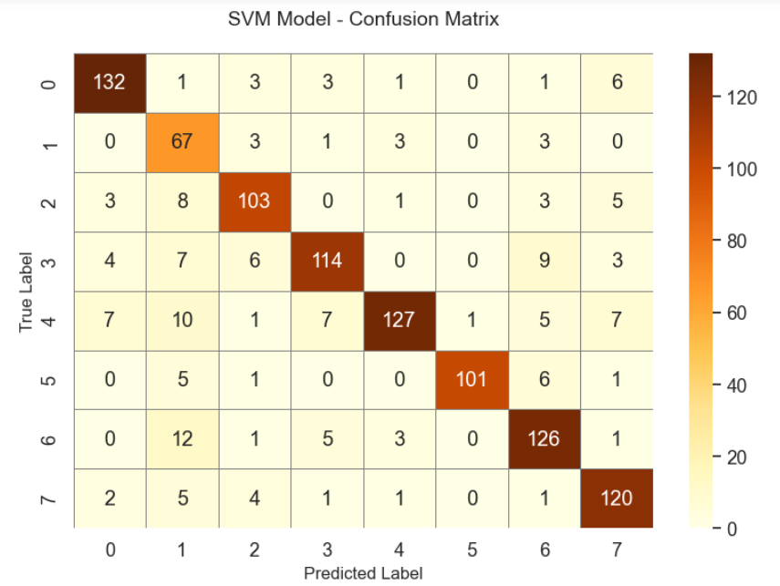
Comparison

Slide 8
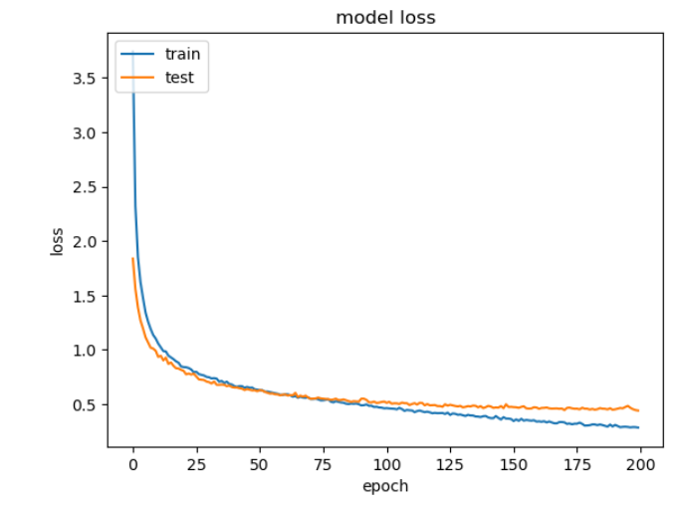
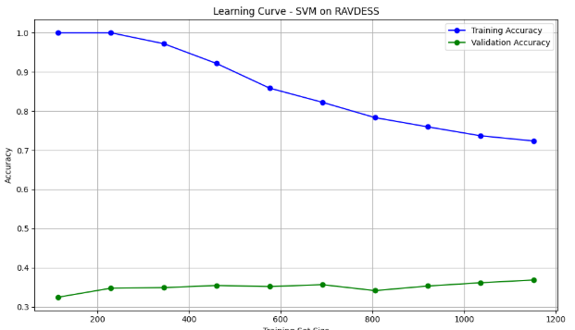
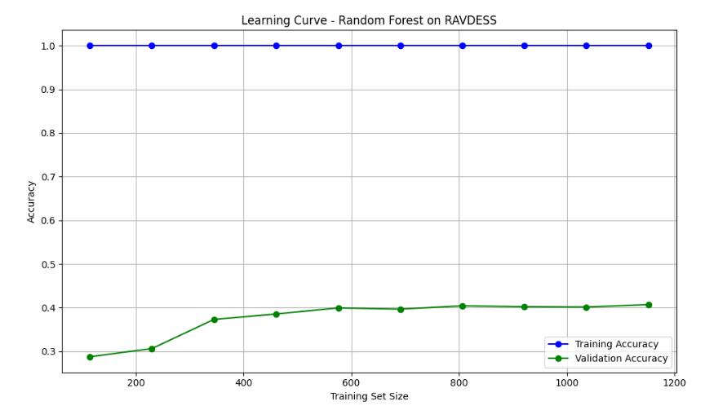

Slide 9

Future prespective
Expanded Multilingual Support:Include more languages and regional dialects to widen accessibility.
Emotion Trend Tracking Over Time:Analyze user mood patterns over days/weeks for better mental health insights.
Mobile Application Integration:Deploy the system as a cross-platform mobile app for on-the-go usage.
Integration with AI Agents & Chatbots:Make virtual assistants more emotionally aware and adaptive in real-time.
Healthcare & Therapy Tools:Collaborate with professionals to assist in remote counseling and diagnosis using emotion trends.
Privacy-Focused Enhancements:Implement edge-computing models for emotion detection without storing sensitive data on servers.

Slide 10

Conclusion
This project successfully implements a dual-mode emotion detection system that analyzes both how something is said (speech) and what is said (text).
By combining deep learning, natural language processing, and multilingual support, the system offers real-time, user-friendly, and accurate emotion recognition.
It has potential applications across smart cities, mental health monitoring, corporate environments, education, and public safety.
A significant step toward building emotionally intelligent AI systems, creating more empathetic, responsive, and human-centered technology.

